Slide 1
Bayesian inference of conformational ensembles from limited structural data
Wojtek Potrzebowski
Data Management and Software Centre, ESS
Biochemistry and Structural Biology, LU
www.europeanspallationsource.se
7 April, 2019
Notes:
Helo. My name is Wojtek and as mentioned I am coming from ESS and before I will talk about the main topic of the presenrtation
it is my pleasure to talk about modelling of conformational ensembles using Bayesian techniques I will like to briefly describe ESS project and how approach software development.

Slide 2
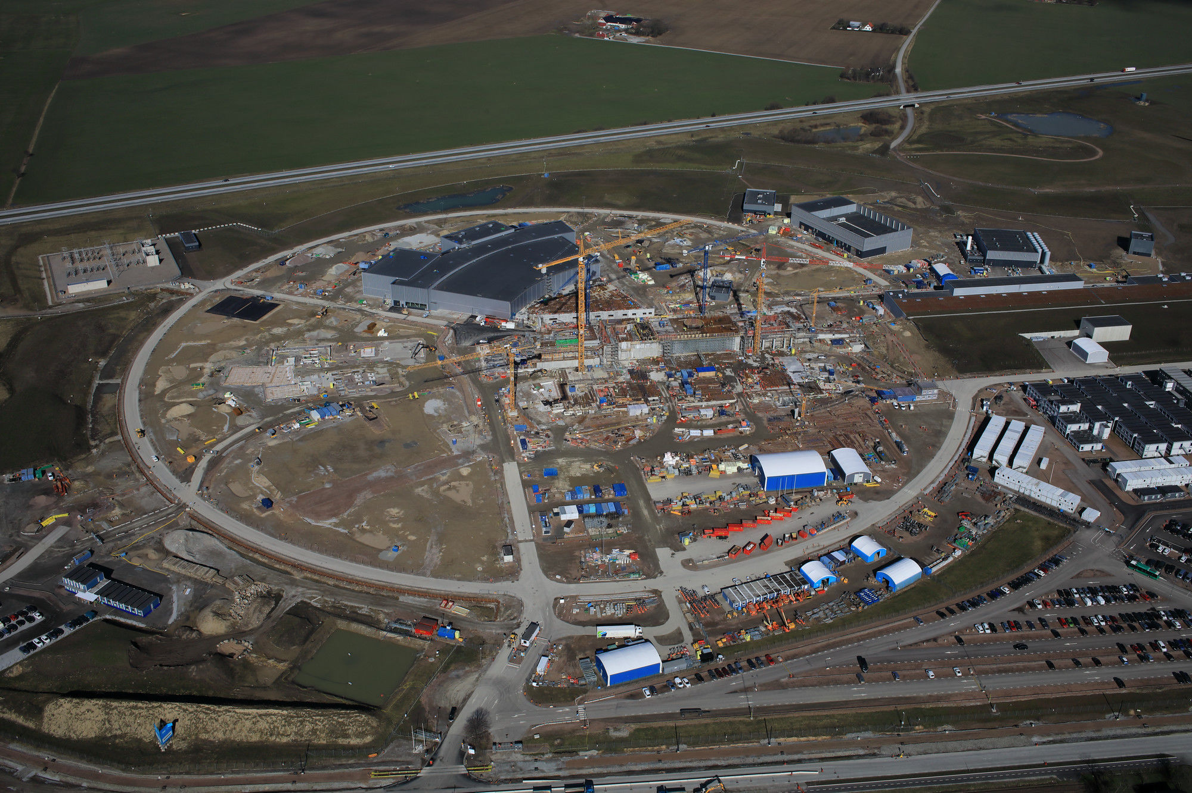
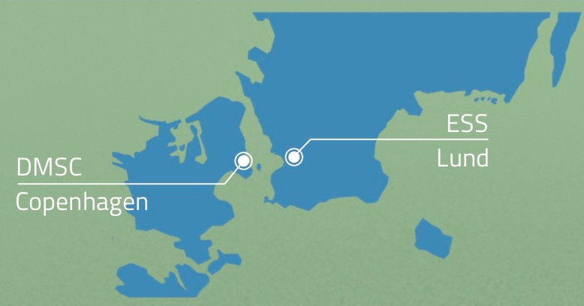
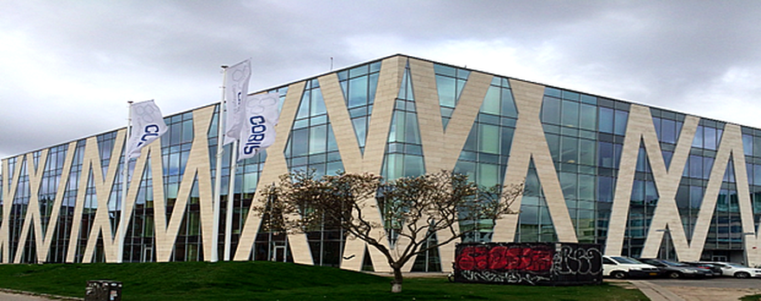
European Spallation Source
60% complete
13 funding members, Sweden and Demark serving as host countries
Pulsed neutron source
More and 100 times brighter neutrons than currently available
Exponentially more data to collect and analyse
Notes:
European spallation source is a pulsed source (opose to the reactor source, which we could opportunity to visit yesterday) curently under construction, which will produce 100x brighter neutron when it is operaring in full mode.

Slide 3

Data Management and Software Centre (DMSC) balances scientific impact with entry barrier
Minimise the time it takes to understand experimental data
Maximise the scientific impact and success of ESS
We follow the best software development practice!
Notes:
The top-level objective of DMSC is to balance entry barrier and the time it takes to understand experimental data with maximising scientific impact of ESS>

Slide 4



ESS/DMSC engages in the collaborations
Ingemar André, Lund University
Jill Trewhella, Univ. of Sydney
Notes:
Present method and how to use it and no Bayesian is required. Screen shot.

Slide 5
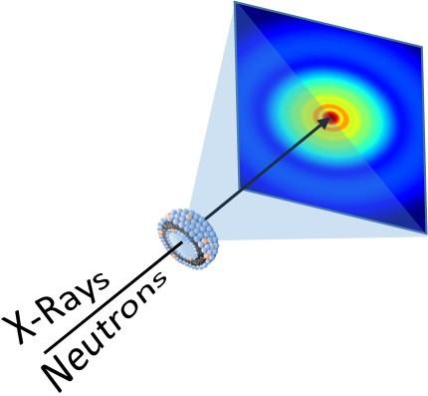
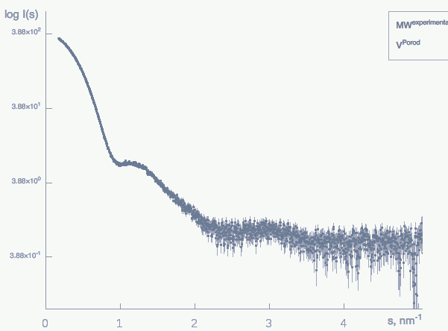
Monodispersity is desired in SAS experiment
X-rays
Neutrons
Monodisperse sample
Adapted from Di Cola et al. Pharmaceutics, 2017
Notes:
Small angle scattering experiemnt is greatly facilitated when it is perfomed on monodisperse molecules. From such data set one can readily extract structural paremeters such as the Rg or molecular mass.

Slide 6
Polydispersity complicates structural determination
X-rays
Neutrons
Shape polydispersity
Size polydispersity
Conformational polydispersity
Notes:
However, very often structure determination is comlicated by the presence of sample polydispersity. Which may involbe shape polydispersity where we have same type of molecule which differs in the overal shape. Size polydispersity wgere we have a mixture of components arrising drom the same builiding blocks and then adopting different oligomeric states. And eventually we can osberve conformational polydispersity where moleciules have same MM but distinctively different conformations. The method I will present in the rest of this presentations can in principle handle of these types of polydispersity. However it will be demonstrated on the case from the last group.

Slide 7
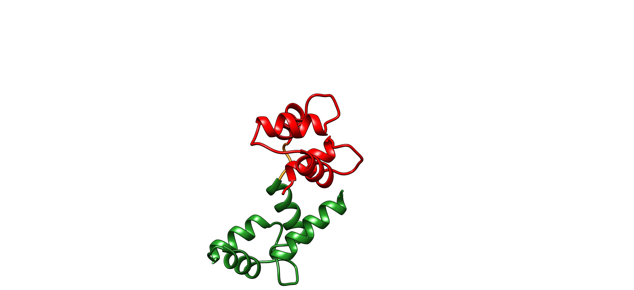
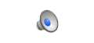
Proteins with flexible linkers are attractive targets for SAS experiments
Calmodulin (CaM)
Cardiac myosin binding protein C (𝛥mC2 )
Notes:
As we’ve been particularly interested in studying two protein systems, which contains two folded comains connected by flexible linker.

Slide 8
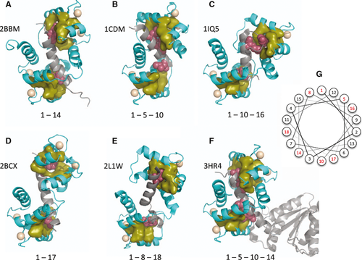
Domain-domain flexibility plays a central role in biology
Structural diversity of calmodulin binding to its target sites, Volume: 280, Issue: 21, Pages: 5551-5565, First published: 20 April 2013, DOI: (10.1111/febs.12296)
Notes:
The reason why we intested in the strcuture of these conformation ensembles is that these different conformation play important biological role as demonstrated for calmodulin (depicted here in olive) that adopts different conformation to bind to different targets (gray).
Canonical binding mode observed in selected CaM-complex structures. (A) MLCK (2BBM) [24]. (B) CaM-dependent protein kinase II (1CDM) [26]. (C) CaM-dependent protein kinase kinase (1IQ5) [90]. (D) Ryanodine receptor (2BCX) [60]. (E) Vacuolar Ca2+ -ATPase (2L1W)
[46]. (F) NOS ( 3HR4) [40]. The spacing of hydrophobic anchor residues is indicated. CaM is coloured cyan, with residues forming a hydrophobic pocket shown in olive. The target peptides are coloured grey, with anchor residues shown in red. Ca2+ ions are shown as beige spheres. The orientations of the CaM N-terminal lobe are identical. (G) Helical wheel indicating the position of anchor residues (red) in an ideal helix. In binding modes with more than two characteristic interacting residues (e.g. 1– 5–10), the ﬁrst and last positions usually constitute the anchor residues.

Slide 9
Challenges for analyzing poldydisperse data
Scattering from the mixture of components
Low information content
Overfitting to experimental noise
Optimization problem – thousands of parameters
Notes:
However analyzing SAS data obtained for such ensembles is not trivial and there are a few major challanges to be faced.
I will go briefly through them as well as will try to explain how we addressed them in the developed method.

Slide 10
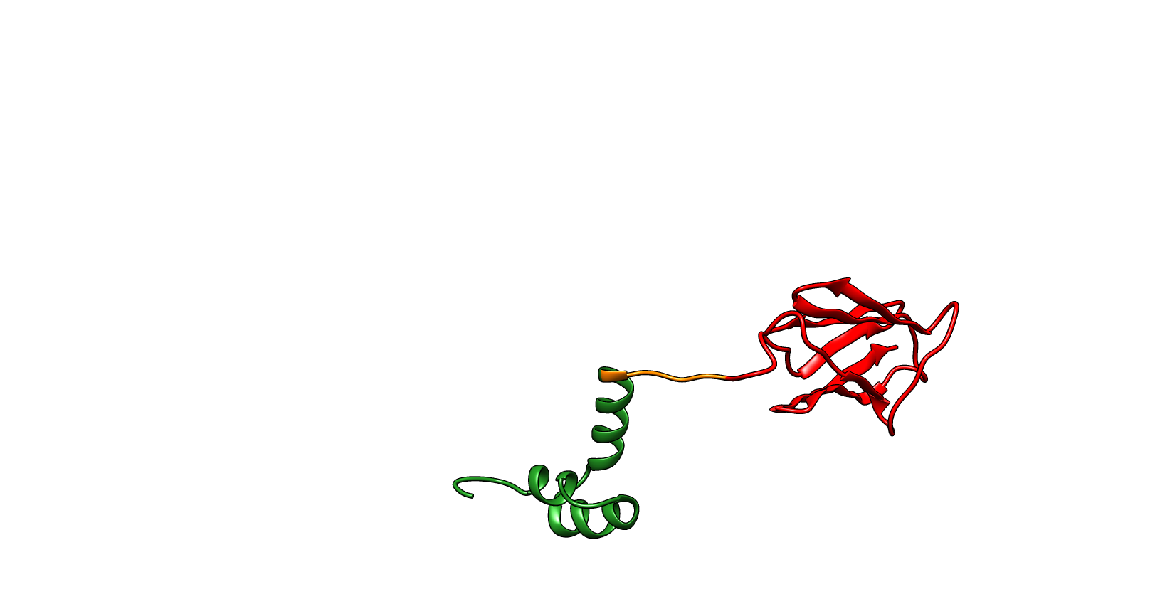
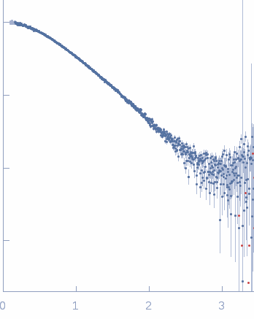
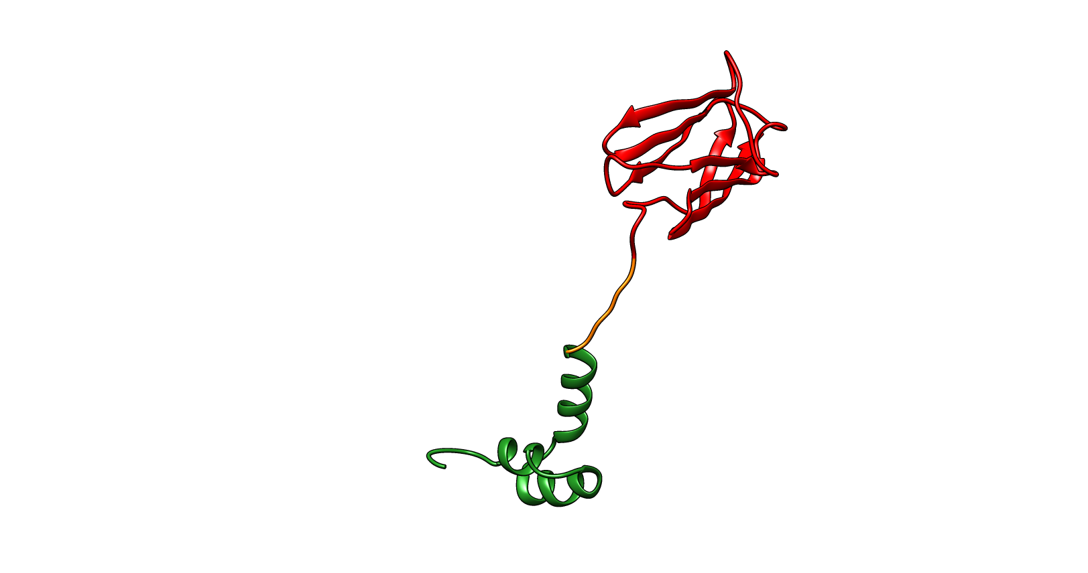
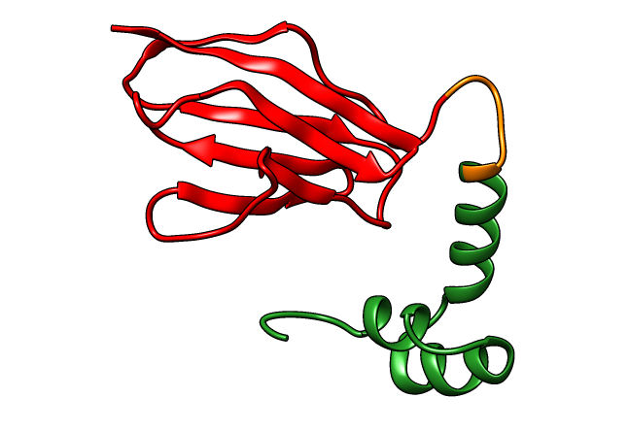
Multiple conformations contribute to scattering curve
w₁
log(I)
w₂
w₃
Q[1/Å]
w₁ +w₂ +w₃ =1
Notes:
As I already mentioned at the begining we consider a polydisperse sample where SAXS data is averaged over different conformations that give rise to the one scattering pattern. In order to define an ensemble we need to define conformation and corresponding population weights,

Slide 11
SAXS data contains limited structural information
The number of independent data points estimated from Nyquist-Shannon sampling theorem or maximum entropy regularization (Vestergaard and Hansen (2006))
Shannon points
Number of points
Good points
Increasing noise
The number of independent measurement rarely exceeds 5-15.
Notes:
The other challenge is related to fundamental loss of information in SAXS experiment. A few attempts have been made to quantify the amount of structural information. The popular method based on Nyqist-Shannon sampling theorem asses number of independent points in the data based on maximu dimension and scattering vector range. It doesn’t however account for noise in the experimental data, which is taken account by method based on the maximum entropy, resulting in the number of good points. The number of good points decreases when the noise increases. Regardless which method we use to quantifiy number of independent points in the data we typically arrive in the range between 5-15. Which limist the number of parameters in the model that can be supported by the data.

Slide 12
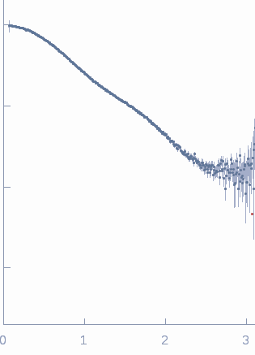
SAXS data contains limited structural information
Calmodulin (SEC-SAXS)
Cardiac myosin-binding protein C (SAXS)
log(I)
log(I)
Q[1/Å]
Q[1/Å]
N_{s} = 6.4
N_{s} = 8.7
N_{g} = 5.1
N_{g} = 6.1
Notes:
For the two systems we’ve been working on number of good and Shannon points are in the range between 5 and almost 9.

Slide 13
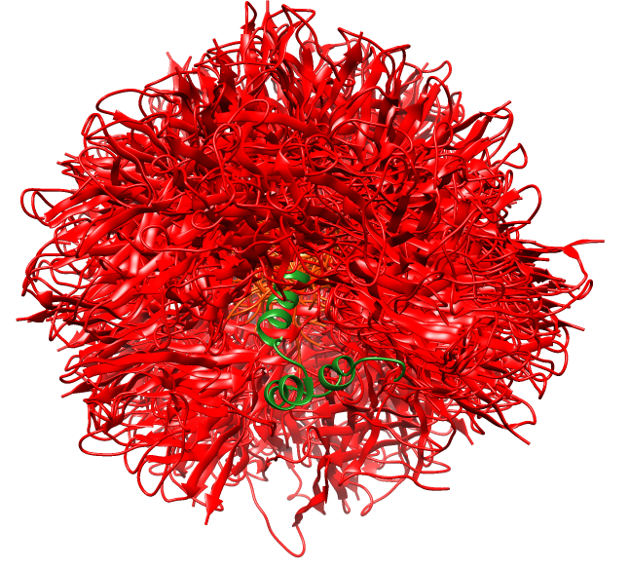
Many parameters describe conformational ensembles
Thousands of parameters may be required to define ensemble
Ensembles can be represented in discrete or continuous space
𝞆² based optimization leads to overfitting
Notes:
As we just established the number of parameters that can reliably supported by the data is in the order of 10. which is typically at least one order of magnitude lower than what is required to represent conformational ensemble. These ensembled can be represented as a continous set of parameters or a discrite set of conformers. In any

Slide 14
What do we want from our inference method?
We want to extract as much information from the experimental data as possible
Avoid overfitting to experimental noise
Quantify the uncertainty in the inference
Combine multiple sources of data: simulation and experimental data sources
-> Bayesian Inference to the rescue!
Notes:
These above mentioned challanges define necessary features that inference method should contain. These can be summarized by.

Slide 15
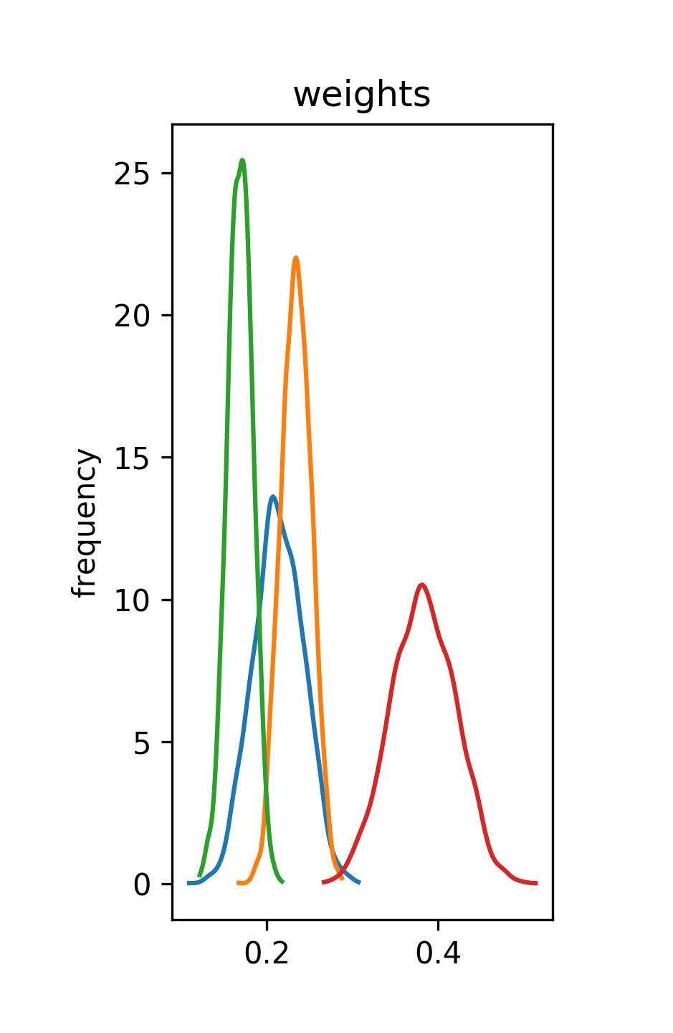
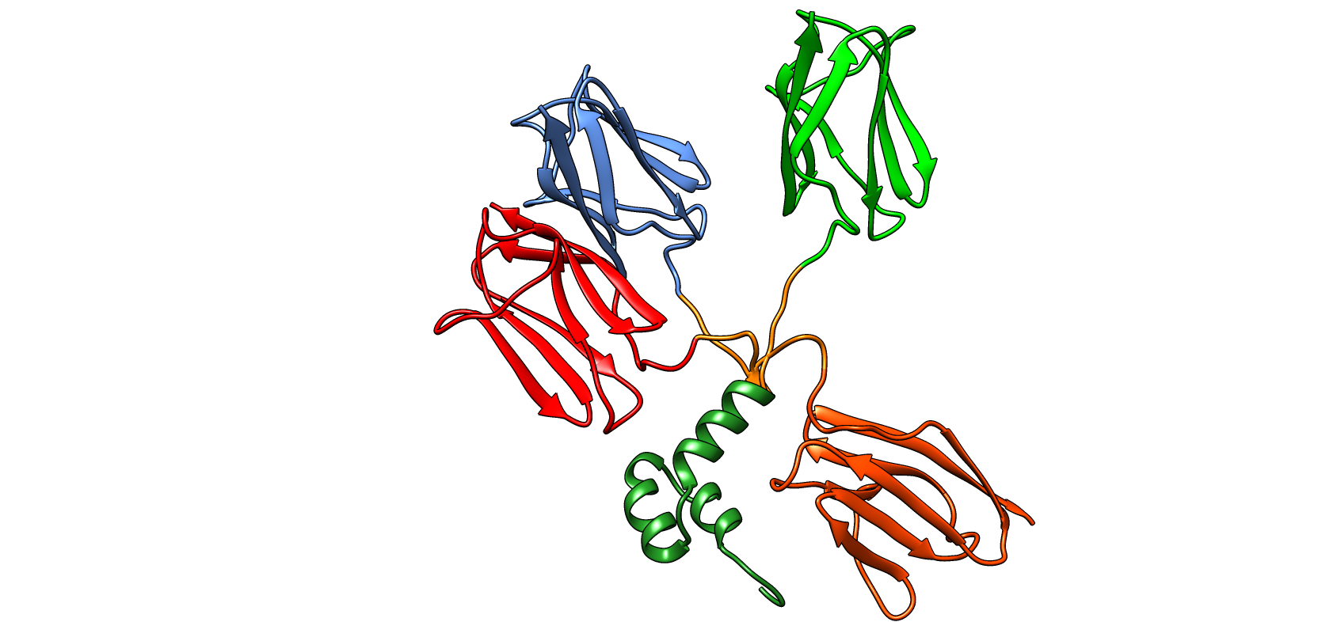
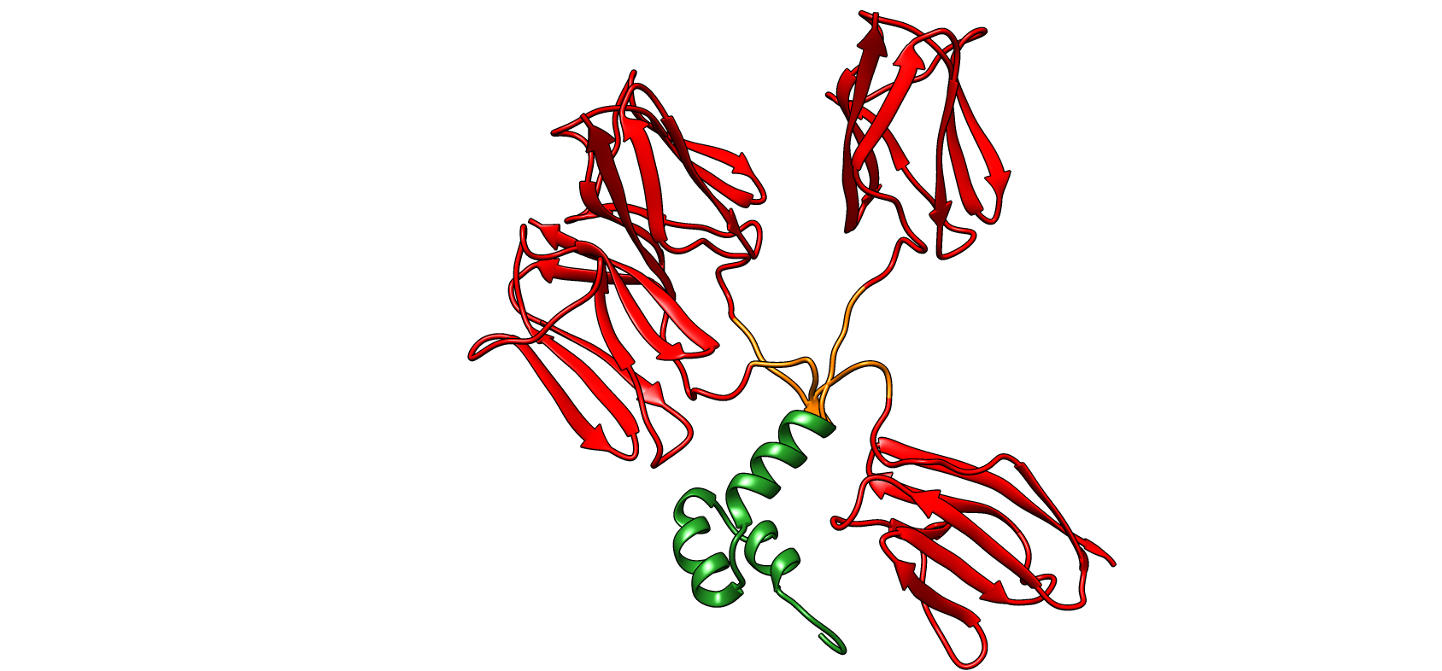
Method to infer conformational ensembles
W₁ = 0.2 W₂ = 0.3 W₃ = 0.5
Monte Carlo simulations
Model selection
Weights inference
SAXS
NMR
Rosetta structure prediction
Approximate Bayesian
Complete Bayesian
Notes:
We developed method that uses Bayesian statistics to determin conformational ensembles from a set of structural discrete models generated Rosetta structure prediction program. Our method primarily works with SAXS data but can also be complemented by NMR chemical shift data. In order to use a full benefit of Bayesian inefernce as well as otimize for speed we are using approximate variational inference to select models an complete Bayesian inference to infer final weights and their distributions.

Slide 16
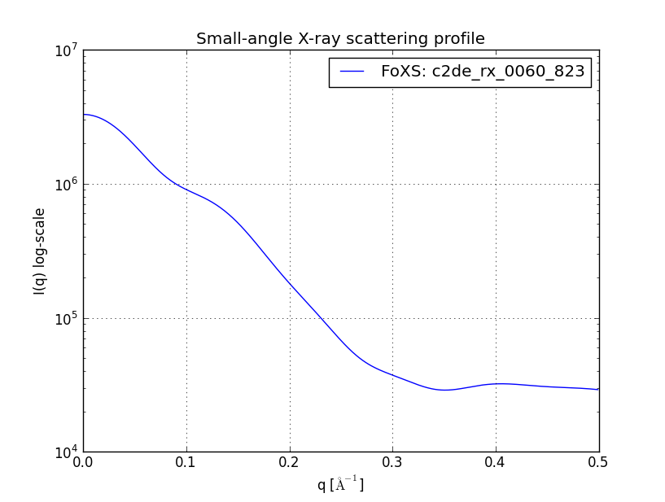
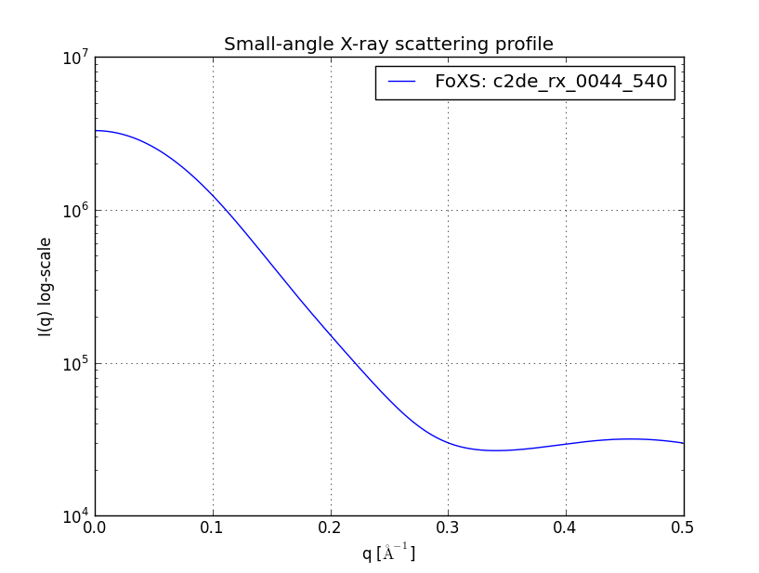
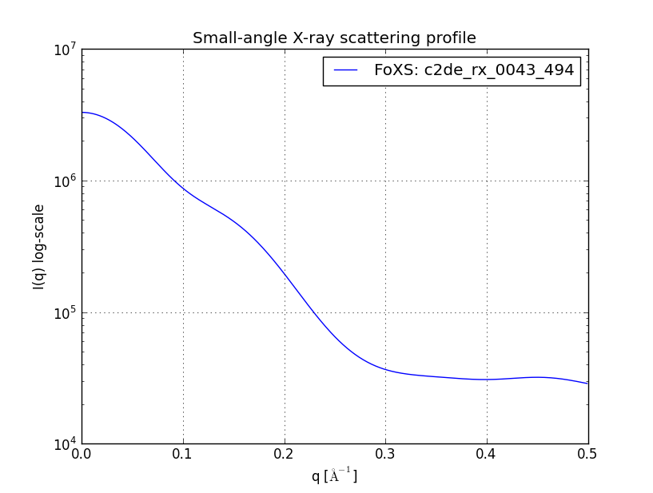
Scattering patterns are generated after Rosetta modeling (once)
Experimental
Crysol, FOXS

Slide 17
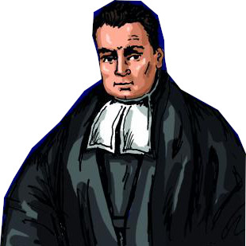
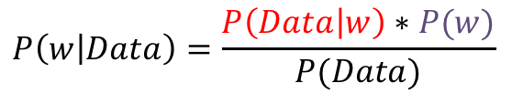
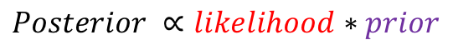
Bayesian statistics can be applied to infer weights
Bayes rule:
$$P\left(w | Data\right)=\frac{P\left(Data | w\right)∗P(w)}{P(Data)}$$
P(weights)
$$Posterior ∝likelihood∗prior$$
Thomas Bayes
weights
Posterior $\left(P\left(w | Data\right)\right):Probability of w after observing data$
Prior ($P(w)):Information before observation of data$
Likelihood ($P\left(Data | w\right)):Probability of observing data given w$
$$P\left(Data\right):Normalization constant also refered to Model evidence$$
Notes:
Just a quick reminder about Bayesian statistics as we already heard a bit about them. Bayeisna inference is governed by a simple Bayes rule which couples priror distribution with likelihood functions in order to obtain posterior probability distribution over the parameters of intrest, which is normalized by the constant also refered as model evidence. Visulay illustrated at this small graph.

Slide 18
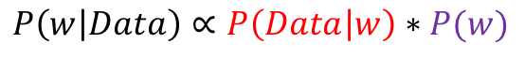
Approximate and complete inference complements each other
Approximate Bayesian inference – fast, less accurate:
Dirichlet distribution
Normal distribution
Simulated annealing
$$P\left(w, Ensemble | Data\right)∝P\left(Data | w, Ensemble\right)∗P(w|Ensemble)$$
Assume Dirichlet distribution
Complete Bayesian inference - slow:
Normal distribution
Dirichlet distribution
Hamiltonian
Monte Carlo
$$P\left(w | Data\right)∝P\left(Data | w\right)∗P(w)$$
Notes:
The variants of Bayesian inference we are using in our method are also governed by thsi rule and can be defined in simillar. The main difference arise from the fact that in the variational inferece conformations in the ensemble are optimized. This optimizatin us convinently dobe using approximate inference as we trun it into optimization problem by assiming the type of posterior distribution, which allows both for complexity quantification and speed up. Complte Bayesian inference is slow but it is perfomred on the limitted set of conformers and is perfomed using Hamiltonian Monte Carlo sampling. For the completness of definition of the terms in Baye rule I should mention that we use Dirichlet distribution to define priors, which is due to the fact that parameters in this distribution sum up to one, which is convinet way to constrai population weights. And that we apply Normal distribution to define likelihood functions.

Slide 19
Combining multiple data sources increases structural information
$$P\left(w | SAXS,NMR, conformer energy\right)∝P\left(SAXS | w\right)∗P\left(NMR | w\right)∗P(w\left(conformer energy\right))$$
SAXS data –
Rigid body orientation of domains
NMR chemical shift data –
Local contacts
Energy of conformer from energy function –
stereochemistry and intramolecular interactions
Notes:
This is also tru for NMR data and we additionally assime that each data point is indepent, which makes the overall formulation of likelihood function mathematically tractable. And this how we describe experimental data. In contrast in order to incorporate information about energy of the conformers that we obtain from molecular simulations with Rosetta we bias the definition of prior. Alltogher we have a framweork to introduce different sources of structural data.

Slide 20
Approximate Bayesian inference balances complexity with fit to the data
Fisher CK, Ullman O, Stultz C. (2012 )
Pacific symposia on biocomputing.
For a given set of conformers
Infer weights of all members of ensemble
Remove conformers with population below a threshold w_{cut}
Evaluate model evidence
$$P\left(w, Ensemble | Data\right)=\frac{P\left(Data | w,Ensemble\right)∗P(w|Ensemble)}{P(Data|Ensemble)}$$
Model evidence
$$P\left(Data | Ensemble\right)∝P\left(Ensemble | Data\right)$$
Notes:
I just also want to briefly mention some algorithimic details of approximate inference. The algorithm works iteratively by infering weights for a given set of conformers and then removing this which are below preset threshold wcut. Once this is done the model evidence is caluclted for selected ensemble and it is further compared with ME from previous run. If it imporves algorithm continues if not final ensemble is returned. It can be demonstrated that by optimizing model evidence, which is this denominator in the Bayes rule, we also optimize the ensmeble model given the data, which really neat approach to balance complexity to the fit to the data.

Slide 21
Method to infer conformational ensembles
W₁ = 0.2 W₂ = 0.3 W₃ = 0.5
Monte Carlo simulations
Model selection
Weights inference
SAXS
NMR
Rosetta structure prediction
Approximate Bayesian
Complete Bayesian
10 000 decoys
(1000 low energy)
3-5 conformers
3-5 conformers
Notes:
Just to remind the workflow our method before I will move on to discrbing results. We genarate about models using Rosetta structure prediction software and then we take 1000 of lowest energy. This 1000 models are subject of variational inference, which in two sytesm we explored arrived at ensembles consisting of 3-5 members and these ensemble were subsequently subject of complete Bayesian inference of weights.

Slide 22
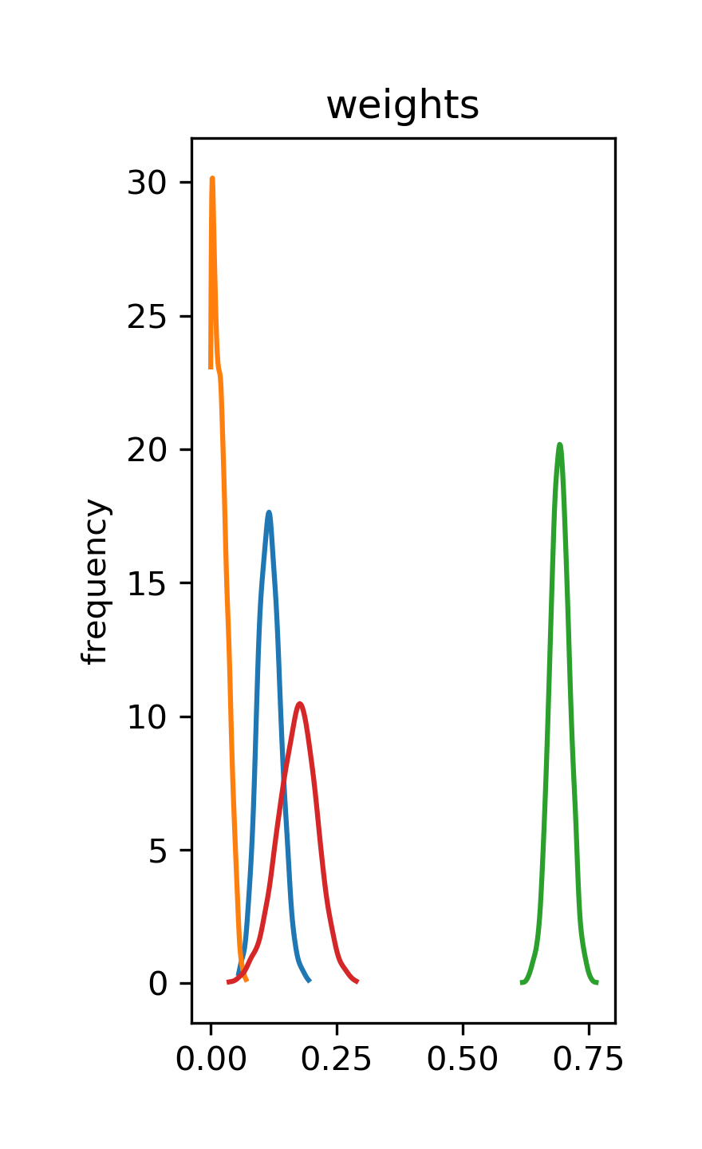
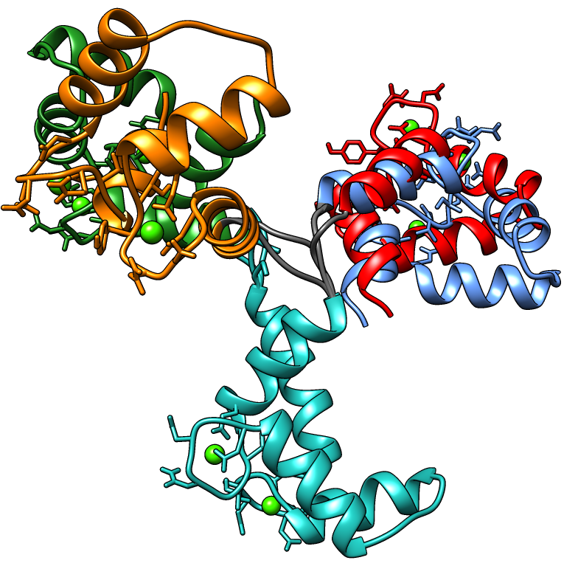
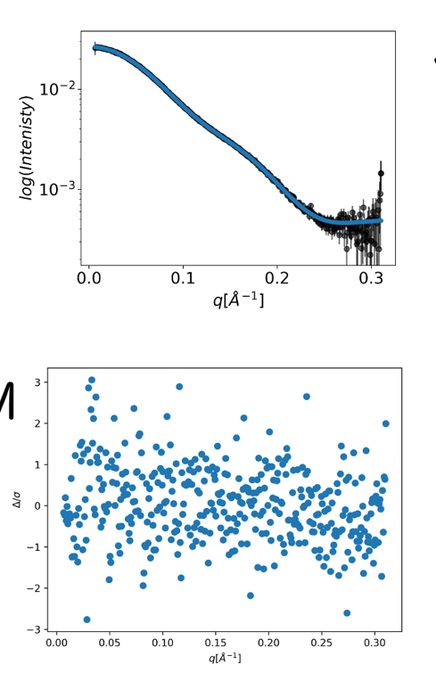
Calmodulin ensemble inferred from SAXS data
posterior ∝ likelihood(SAXS) ・ prior(weights)
1
JSD=0.07
3
χ²= 0.83
2
4
Conformer | Population weight
1 | 0.02 ± 0.01
2 | 0.69 ± 0.02
3 | 0.17 ± 0.04
4 | 0.12 ± 0.02
Notes:
To briefly ilustarte how, the results of the inference of calmoudlin ensemble from SAXS data look like. Using variationall inference we obtained ensemble of 4 models, for which inference population weights and their distributions (shown here on the graph) and in the table.
For each of weights we can asses uncertainity as well as we can do it for entire ensemble, which can be confinently done by calculating measure called JSD introduced by Fisher and collegues. The resulting ensemble gives good fit to SAXS data, which is illustrated by fit and residuals plot.
Fisher et. al. developed a useful metric to measure the uncertainty of an inferred ensemble, the expectation value of the Jensen-Shannon divergence (JSD) relative to the optimal weights over the posterior distribution.
JSD ranges between 0 and 1 for two maximally different and identical vectors, which means that also $σ_{{\vec{w}}_{B,S}}$ falls within this range. Zero line. Colors to weights

Slide 23
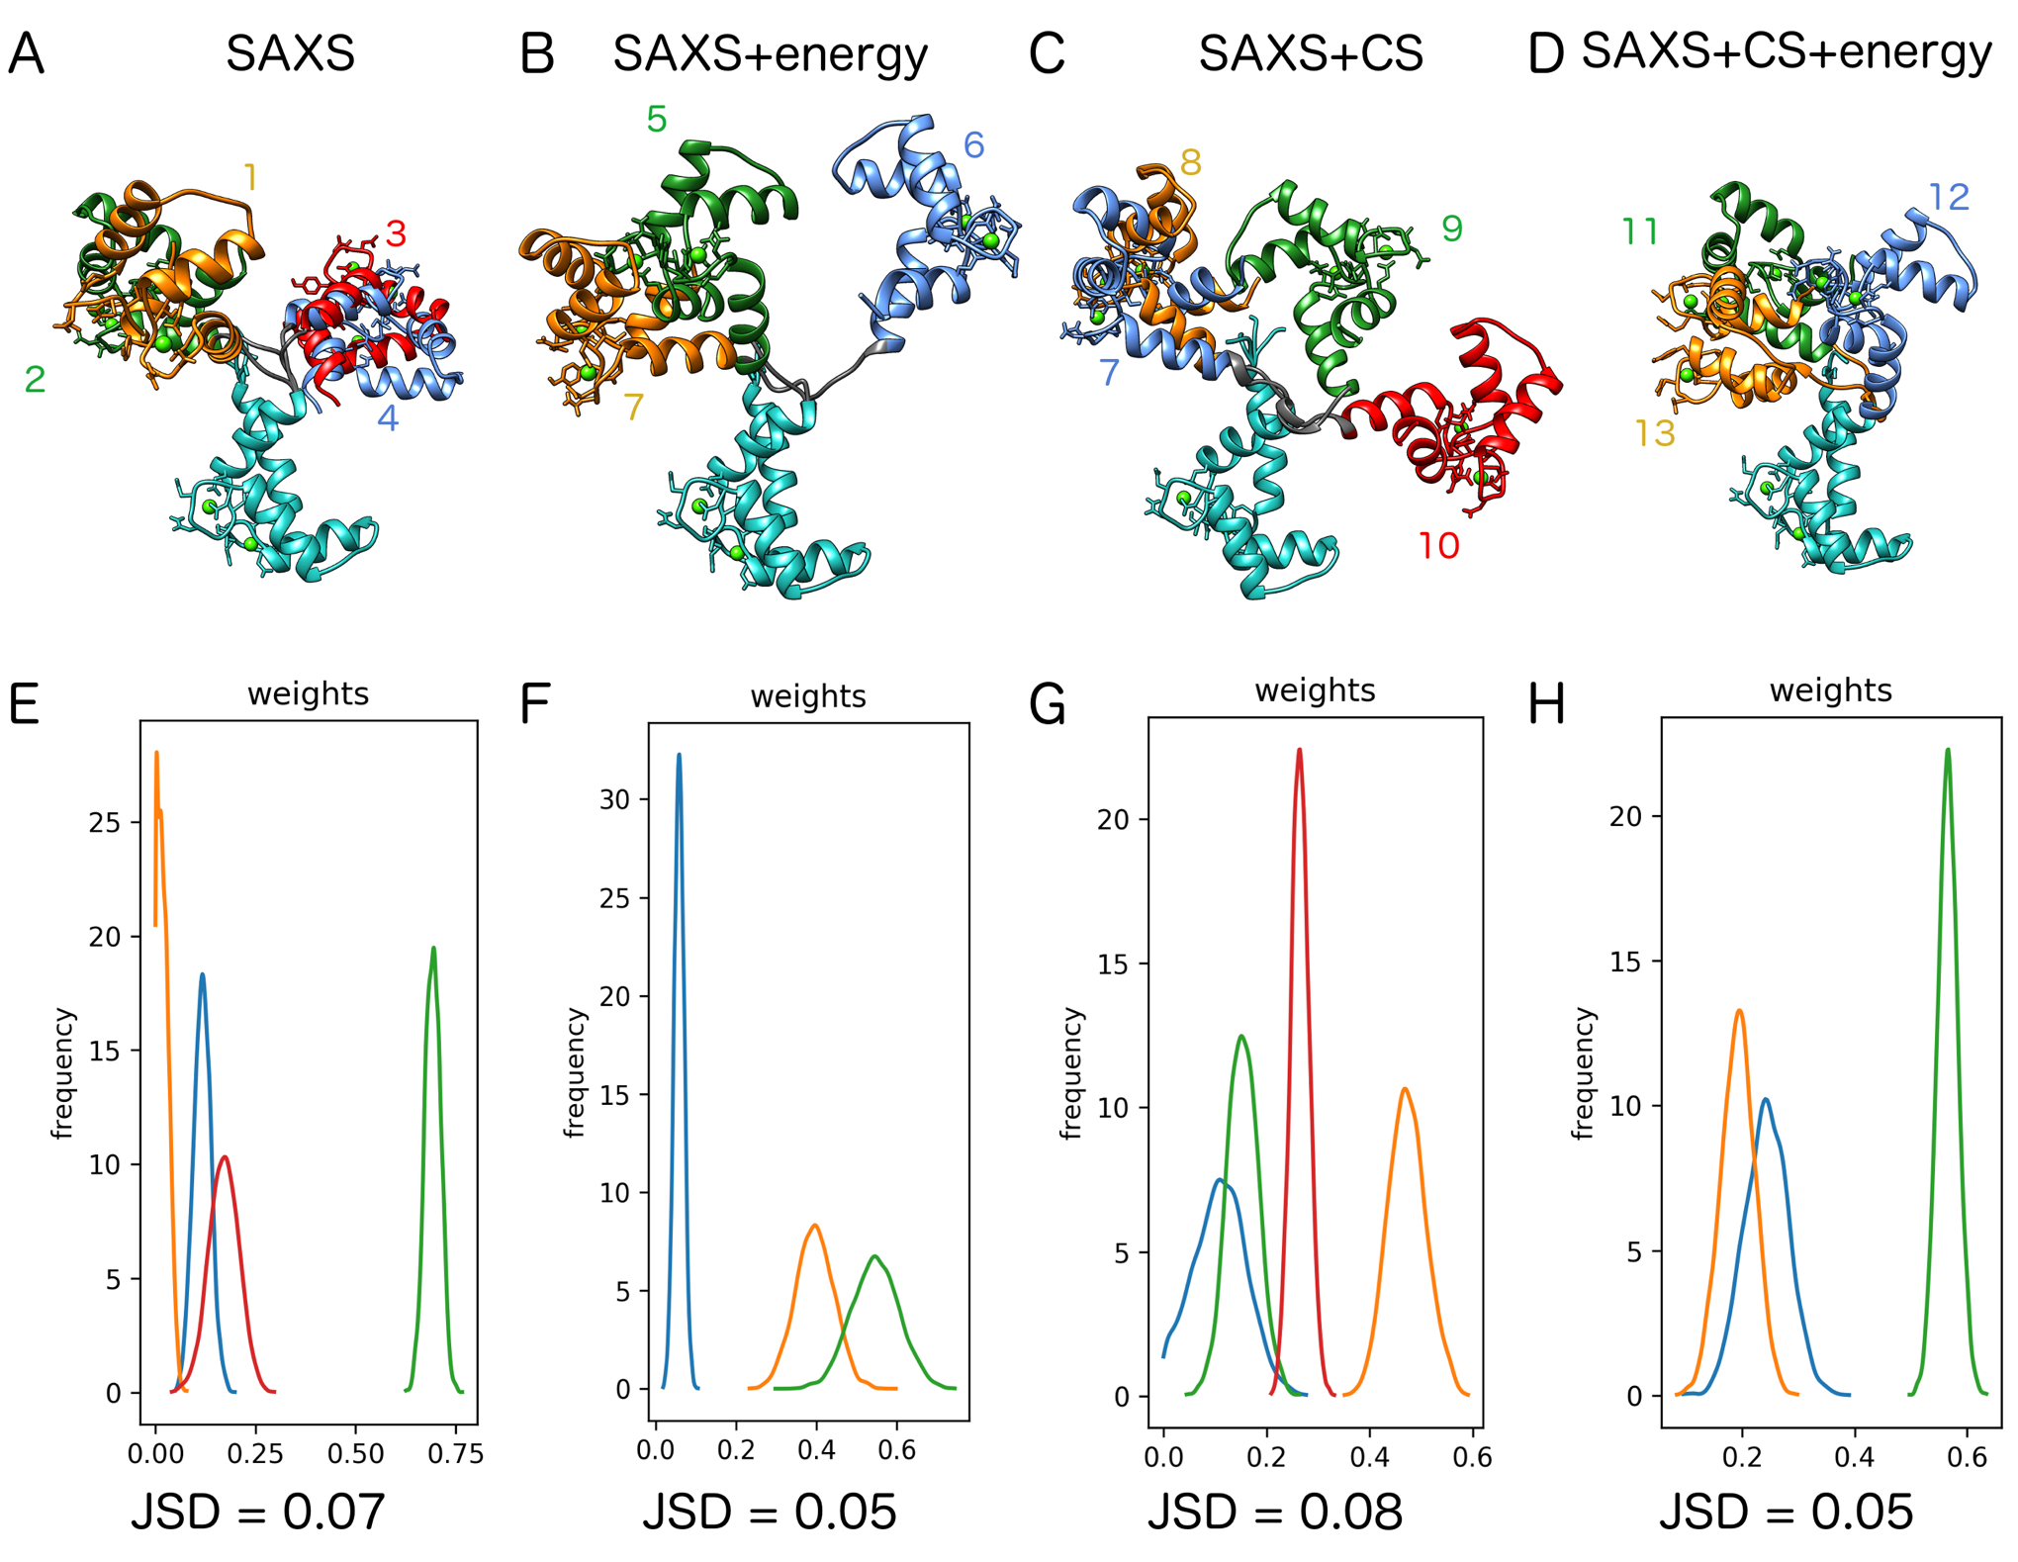
Combination of different data sources explains SAXS data equally well
energy = energy from molecular simulations
CS = NMR chemical shifts
JSD = Jensen-Shannon weights divergence
𝞆²=0.83
𝞆²=0.87
𝞆²=0.81
𝞆²=0.87
Notes:
We also obtained similar fits when we used different sources of structural information, namely NMR CS and energy from molecular simulations, even though ensembles are structurally different and JSD improves when molecular energies are added, which corresponds to lower unceratinity of the weights. It should be noted here that CaM data are of supreme quality, which lead to consistent fit to the ddata.

Slide 24
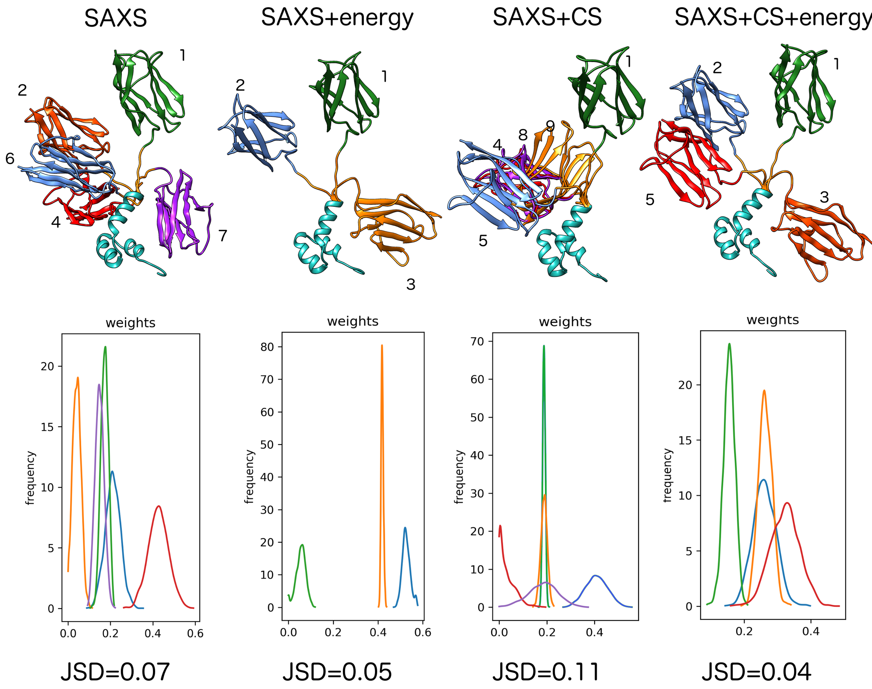
Combination of different data sources improves definition of 𝛥mC2 ensemble
energy = energy from molecular simulations
CS = NMR chemical shifts
JSD = Jensen-Shannon weights divergence
𝞆²=3.77
𝞆²=3.55
𝞆²=3.81
𝞆²=3.56
The drop in 𝞆² is the result in the improved quality of ensemble
Notes:
This is however is not always the case and in our second case study, which was based on the lower quality data, we can observe more drastic improvement of the fit to saxs data when additionat structural information is incorporated. It should be noted here that we are not optimizing chi2 to saxs data, so the fact that it decrease is improvement of the overall definition of the ensemble.

Slide 25
Conclusions I
Bayesian Inference:
can be used to optimally balance model complexity and fit to experimental data
gives information about the uncertainty of inferred ensembles and parameters
allows for combining information from different data sources in one model
Our method combines the speed of alternative methods with the benefits of Bayesian inference

Slide 26

Method is available for download
https://andre-lab.github.io/bioce/

Slide 27








Exploring protein association pathways with time resolved SANS/SAXS
Ingemar André
(LU)
Ryan Olivier
(LU)
Najet Mahmoudi
(ISIS)
Thomas Holm Rod
(ESS)
Martin Nors Pedersen
(KU)
Lise Arleth
(KU)

Slide 28
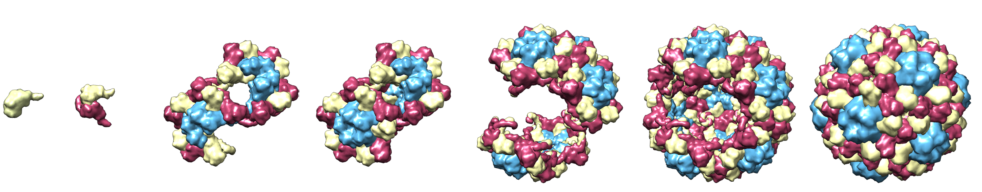
Why to study protein association pathways?
Self-assembly central to many processes in different domains
Key to understanding life processes at molecular level
For virus capsids:
Start and end points are often known
But not what happens in between
E.g. critical in designing antiviral therapies
Time (sec - hours)
Cowpea chlorotic mottle virus association pathway?
Notes:
Molecular self-assembly is a central concept in chemistry, soft matter physics and biology. In biology, the spontaneous association of smaller building blocks into more complex functional assemblies – membranes, folded proteins and protein complexes – is key to understanding life processes at the molecular level. The overall goal of our research is to determine how protein subunits self-assemble into larger assemblies and to understand how complex association pathways are encoded in protein sequence. While we in general have a fairly sophisticated view of the starting and end points for protein self-assembly reactions – the high-resolution structures of the building blocks and the final assembled complex – much less detail is known about the pathways between those states.

Slide 29
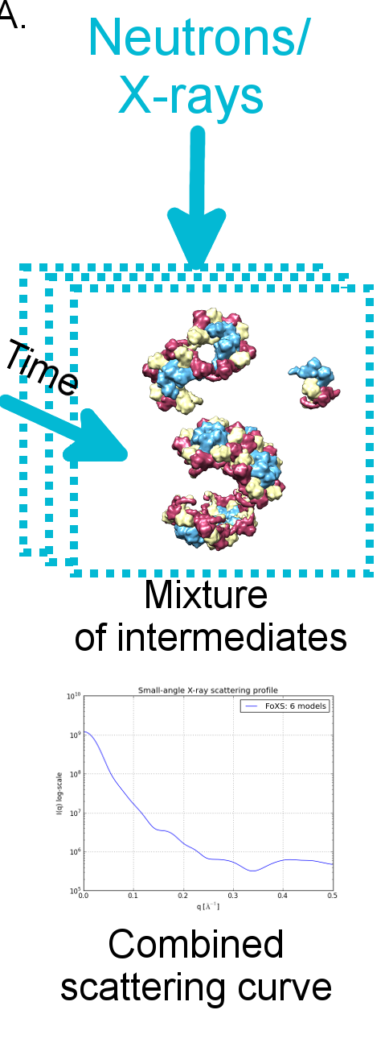
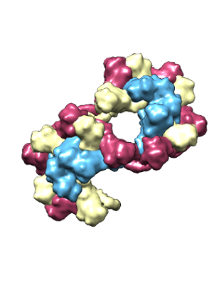
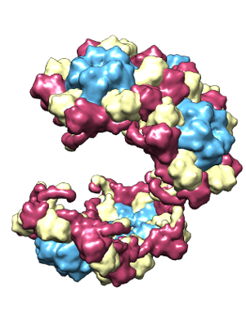
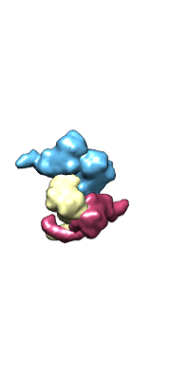
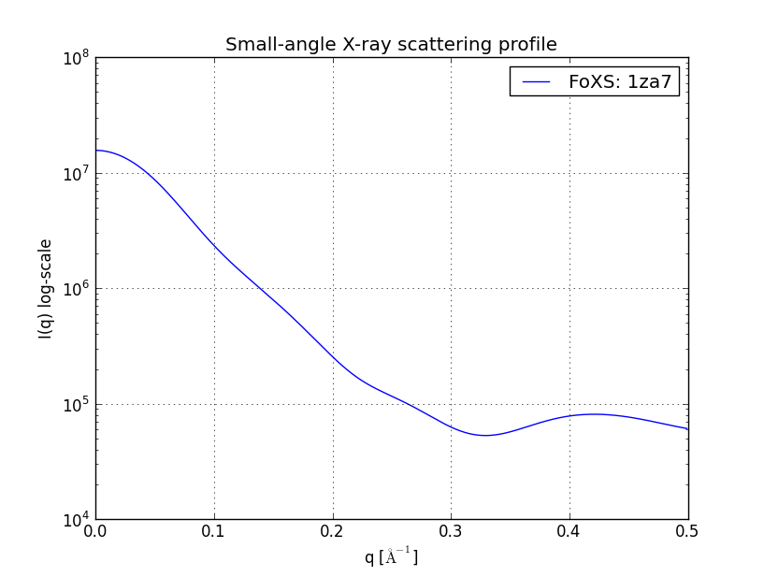
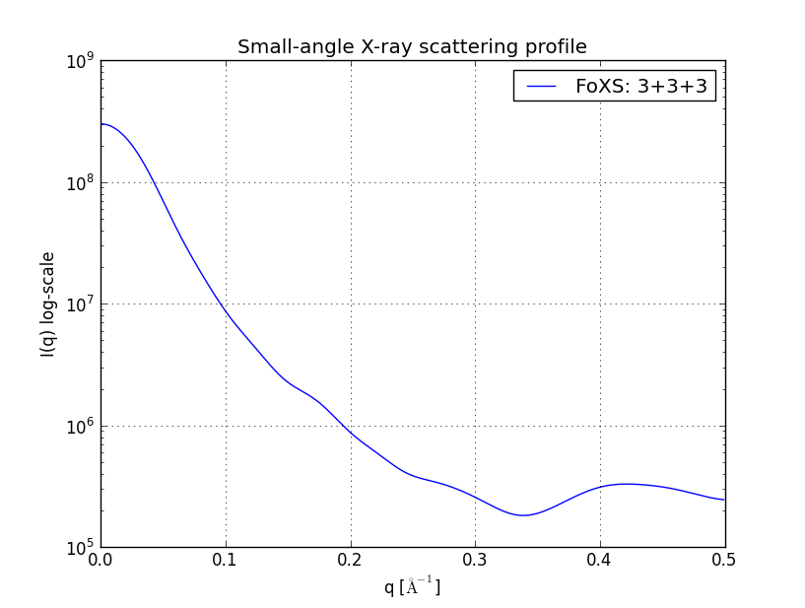
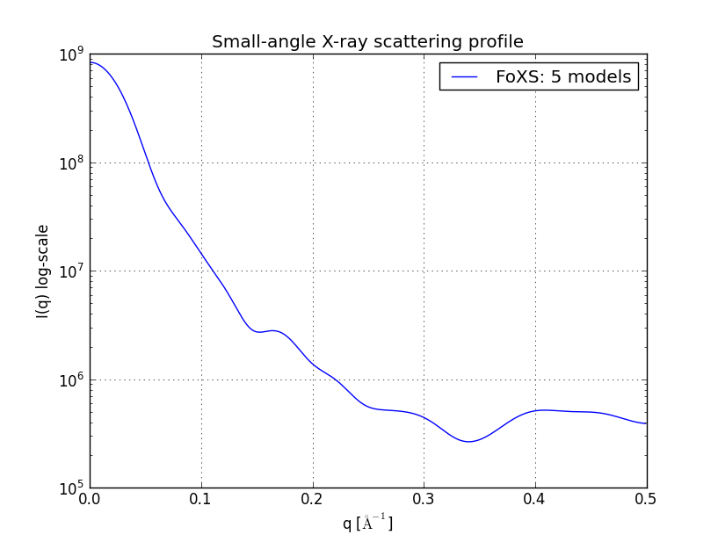
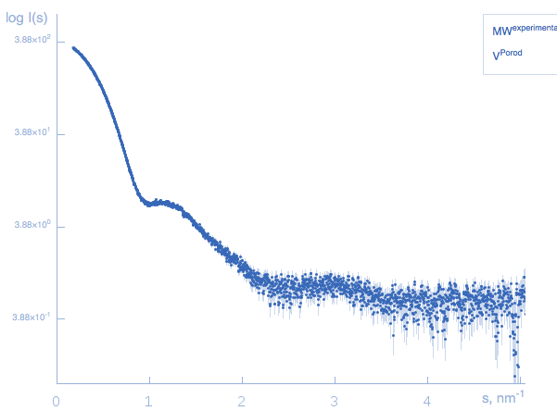
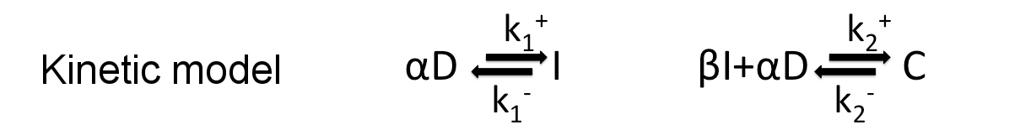
Method for analyzing SAS data from the mixture of components
t=t₁
w₁
w₂
w₃
=
+
+

Slide 30
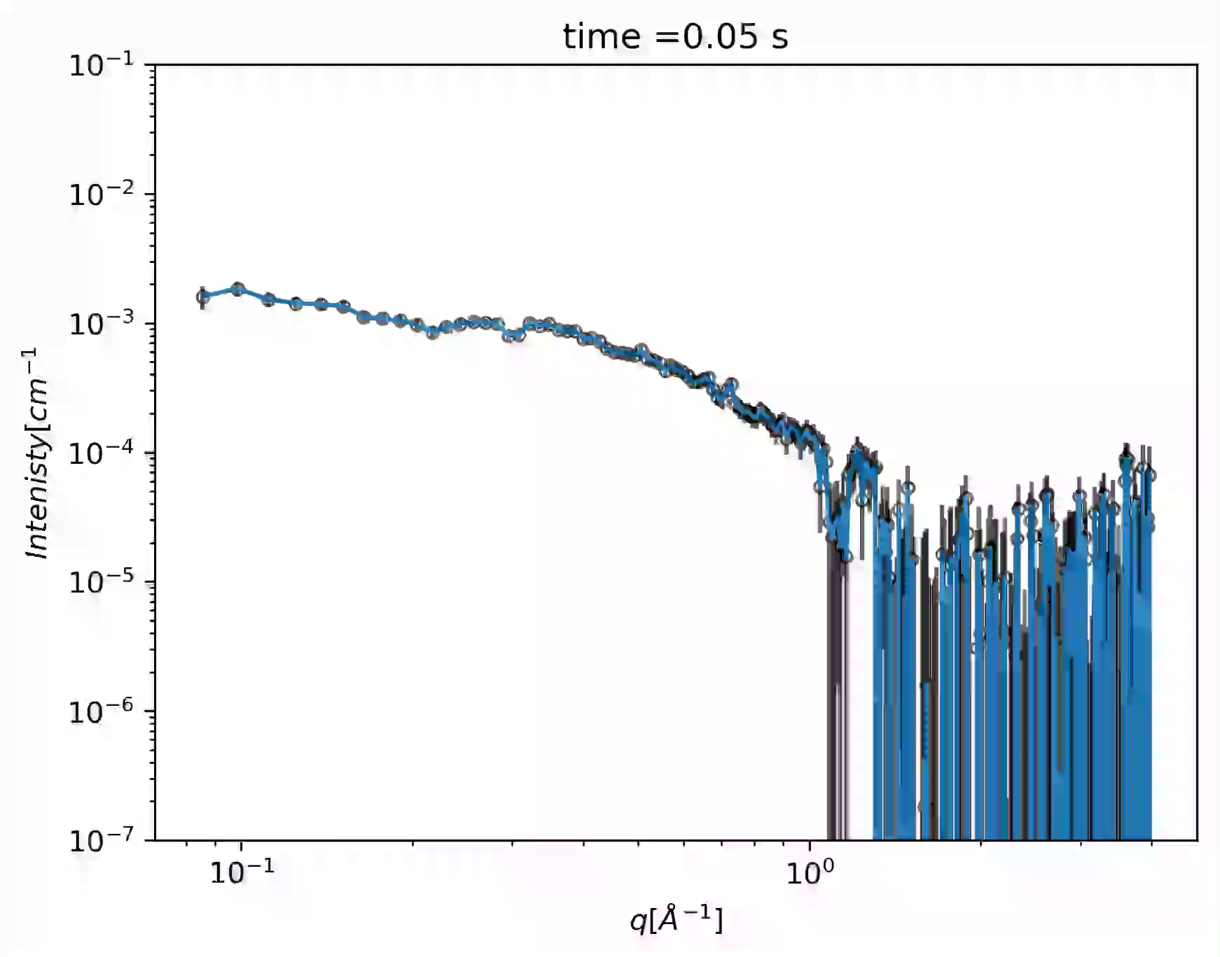
Time-resolved SAXS captures virus capsid assembly
Data collected at ESRF, ID02, Nov. 2018

Slide 31
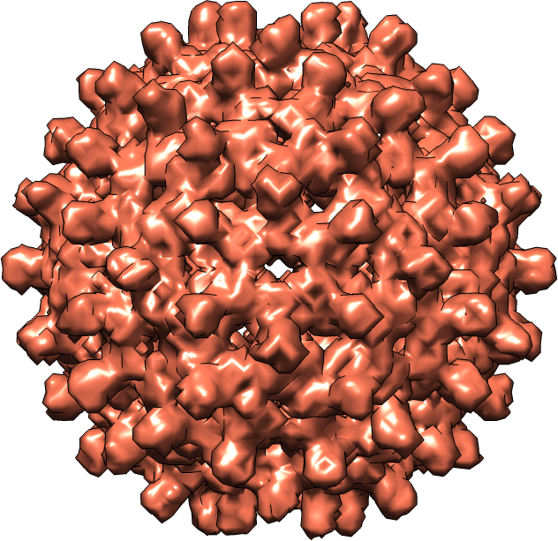
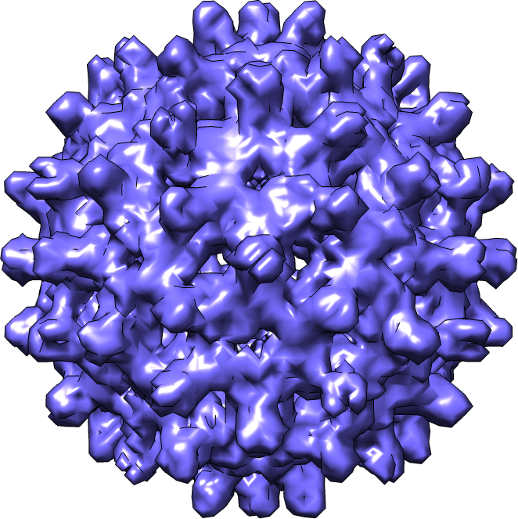
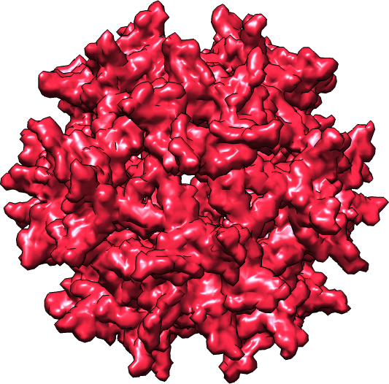
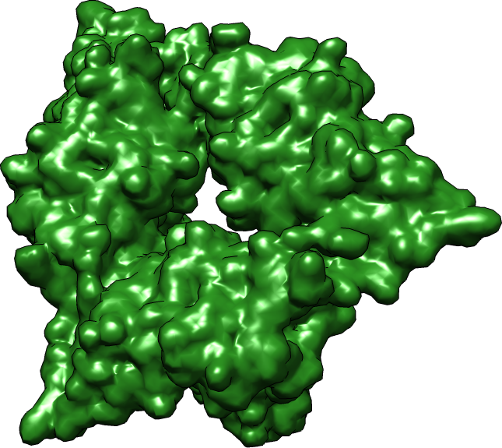
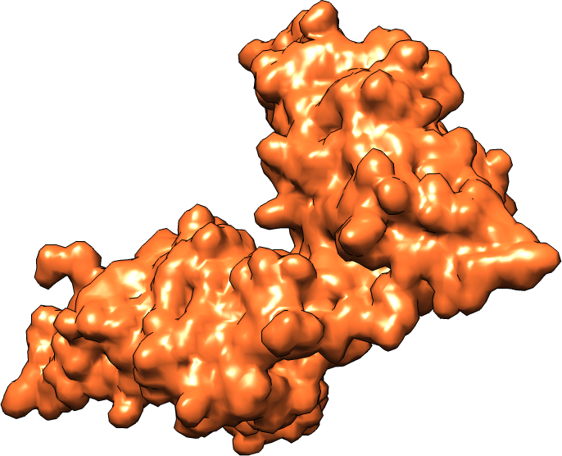
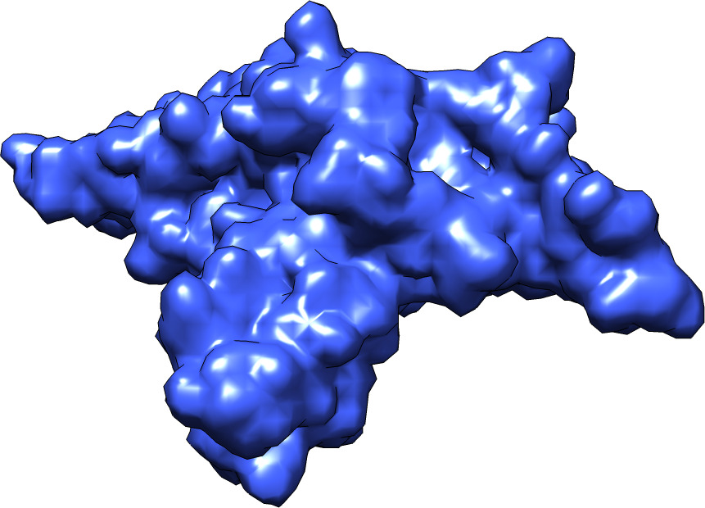
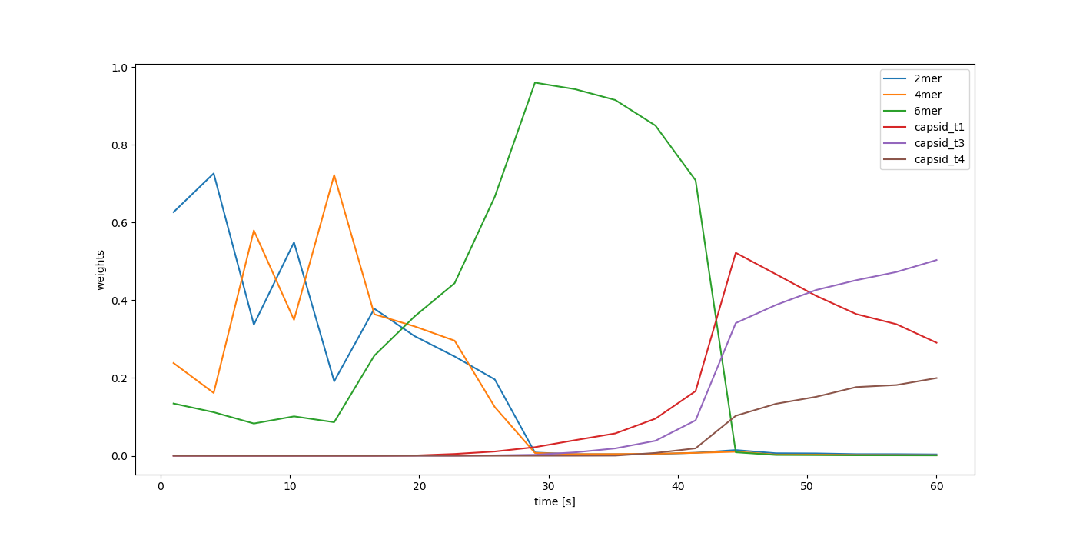
Intermediates can be inferred from time-resolved SAXS data

Slide 32


SasView analyzes and models SAS data
Community driven project
30 developers from X-ray and neutron facilities
Engaged user community
Regular code camps and releases
We collaborate
Fitting geometrical models to data
P(r) inversion
Model-free calculations
Correlation functions
Numerous utility tools
Code Camp IX, March 2019

Slide 33
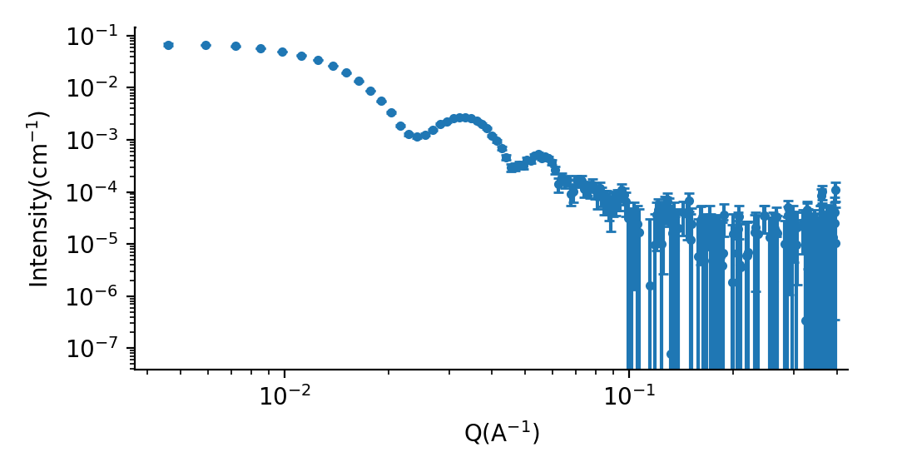
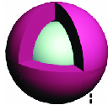
Bayesian inference combines atomistic and coarse-grained models
End state
Parameter | Value
Weight T3 capsid | 0.40±0.02
Weight T4 capsid | 0.15±0.03
Weight core shell sphere | 0.45±0.05
Core radius [Å] | 88±10
Shell radius [Å] | 30±4

Slide 34
Conclusions II
Bayesian inference methods can be adapted to analyze time-resolved SAXS data
Models of various accuracy can be combined into a single statistical framework

Slide 35


Thank you!
Lund University:
Ingemar André
Ryan Oliver
ESS:
Thomas Holm Rod
Univ. of Sydney:
Jill Trewhella
ISIS neutron and muon source:
Najet Mahmoudi
Univ. of Copenhagen:
Martin Nors Pedersen
Lise Arleth
SasView collaboration
Funding:
Notes:
Present method and how to use it and no Bayesian is required. Screen shot.

Slide 36
Approxiamte bayesian recovers ensembles up to high level of noise
```
Simulated ensemble with 5 members from a library of 100 conformers

Slide 37
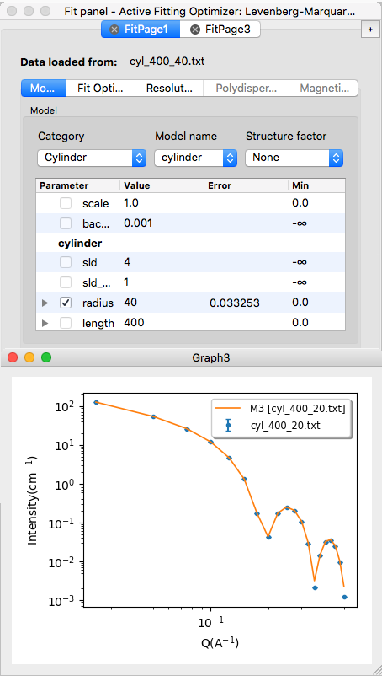









SasView has large collection of models

Slide 38

Variational Bayesian Inference on noisy data
Simulated ensemble with 5 members from a library of 100 conformers

Slide 39
Information content in SAS
From Nyqvist-Shannon sampling theorem
The scattering curve I(q) of object with maximum diameter d is fully represented by a set of points
q_{n} = nπ/d, where n= (1,...,∞).
The number of independent data points (Shannon channels)
N_{s} = d(q_{max}-q_{min})/π
Notes:
So how much information is there in a SAXS spectra? Or equivalently, how many paramters can one support in a model form the data?
This is a question that can be adressed with information theory. The Nyquist-Shannon theory provides a method to calculate the number of data points that is required to fully represent a curve. This is the number of Shannon channels. Expressions of this has been derived for SAXS and analyzis suggest that…

Slide 40




Bayesian ensemble modeling: complete inference
A model (M) is a set a set of structures S. For a given model:
$$P\left(w | D\right)=\frac{P\left(D | w\right)∗P(w)}{\int{P\left(D | w\right)∗P\left(w\right)dw}}$$
The prior of w can be selected as a flat prior or based on Boltzmann distribution
$$w_{i}=\frac{e^{−U(S_{i})/k_{B}T}}{\sum_{j=1}^{n}{e^{−U(S_{i})/k_{B}T}}}$$
The likelihood of w can be modeled as a Gaussian distribution for each data point, d_{i}
$$P\left(d_{i} | w,λ\right)=\frac{1}{\sqrt{2π{ε_{SAXS,i}}^{2}}}\exp\left(−\frac{{\left(d_{i}−λ\sum{w_{i}S_{i}}\right)}^{2}}{2ε_{SAXS,i}^{2}}\right)$$
$$P\left(D | w,λ\right)=\prod_{i=1}^{N}{P\left(d_{i} | w,λ\right)}$$
Notes:
I the next slides I will describe the probabiistic model for the full Baysian inference.
We need a prior and a likelihood function.
For the prior, we are going to use a prior with a gaussian centered around the weight calculated from the Bolzmann probabilty of structure with a certain energy.
For the likelihood function we assume that noise is normally distributed around the true value for each experimental data point.

Slide 41




Bayesian ensemble modeling
Point estimate of w’s:
$$w_{j}^{B}≡{\left\langle w_{j}\right\rangle }_{posterior}=\int{w_{j}P\left(w | D\right)dw}$$
Uncertainty is qualified with a posterior divergence $σ_{w}$ for a vector w:
$$σ_{w}={\left\langle Ω^{2}(w^{B},w)\right\rangle }_{posterior}$$
Where$Ω^{2}(w^{B},w)$ is the Jensen-Shannon divergence between vector $w^{B} and w$
0 $≤ σ_{w}≤1$
$σ_{w}$=0 if there is no uncertainty in population weights
Notes:
To calculate an estimate for the indivial weights we calculate an expectiation value for each weight based on the posterior probability distribution.
The cool thing with Bayesian analysis is that we can provide a metric for a uncertainty of a given weight vector w, refered to as a posterior divergence sigma. Sigma is a number of that goes between 0 and 1. If sigma is close to zero the probability distribution is highly peaked around the point estimate w. If sigma is close to one then w is a bad selection.

Slide 42




Approximate inference with
variational Bayes
$$P\left(w | D,S\right)=\frac{P\left(D | w,S\right)∗P(w|S)}{P(D|S)}$$
G$\left(w | α,S\right)$ is selected to make analytical derivation possible
G$\left(w | α,S\right)=\frac{Γ(α_{0})}{\sum_{i=1}^{l}{Γ(i)}}\prod_{i=1}^{l}{w_{i}^{α_{i}−1}}$
This is the Dirichlet distribution where $\sum_{i=1}^{l}{w_{i}=1}$
For the prior we select an non-informative prior (Jeffrey’s) Dirichlet distribution
P$\left(w | S\right)=\frac{Γ(n/2)}{\sum_{i=1}^{l}{nΓ(1/2)}}\prod_{i=1}^{l}{w_{i}^{−1/2}}$
Or informative prior based on Boltzmann distribution

Slide 43

Overfitting
More complex models will always fit the data better but risk fitting to noise
Model fitting typically involves optimization of likelihoods (Maximum likelihood)
$$χ^{2}=\frac{\sum_{i=1}^{N}{{({{I(q}_{i})}_{data}−{{I(q}_{i})}_{model})}^{2}}}{σ_{i}^{2}}$$
Optimization based solely on $χ^{2}$ can lead to overfitting
From “Pattern recognition and machine learning” Bishop (2006)
Notes:
So we have to worry about overfitting. A more complex model will always be able to fit to the observed data better than a less complex model. But at some point we start to fit to noise in the data.
The traditional method of fitting a model to data is to minimize the difference between a model and observed data. This is eqivalent to maximize the likelihood function we talked about before.
As an example of overfitting I show a figure from Bishops book on machine learning where polynomial is fitted to sine function with added noise. As the degree of the of polynomical increases, the fits get better. But we are clearly ftting to noise. In reality we should probably select the polynomial with degee 3.

Slide 44


Overfitting
Bayes to the rescue!
Embodies the Occam’s razor principle: simpler models are better
Model evidence
$$P\left(D | M_{i}\right)=\int{P(D|θ,}M_{i})∗P\left(θ | M_{i}\right)dθ$$
Figures from “Pattern recognition and machine learning” Bishop (2006)
Notes:
This figure shows the model evidence for the different polynomial modles as a function of model compexity. As you can see the metric suggest selecting a model with 3 parameters is best supported by data.

Slide 45


Calmodulin ensemble compared with PDB structures

